Slide 1
x86 Assembly Cont.
SSTCTF - by Tamir Enkhjargal

Slide 2
Inside a C Program and in Assembly
Heap
Stack
Registers
Instructions

Slide 3
The Heap
The Heap is used for memory allocation, found in the computer’s RAM
HEAP
Static
Global
Instance Variables
Built-in Library Functions

Slide 4
Registers
Small storage containment that holds memory addresses and values
All 8 Bytes or less
Standard Registers in x86
Eax, ebx, ecx, edx ← General registers
Ebp, esp, eip ← Reserved registers

Slide 5
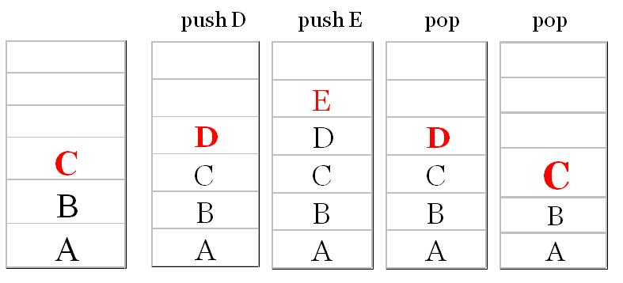
The Stack
Two overall important functions, push and pop
Each stack has an address. The higher you go on the stack, the lower the memory address

Slide 6
Stack Frame
junk
Each stack has a frame
esp = stack pointer ← Calls beginning
ebp = base pointer ← Calls end
esp
ebp
junk

Slide 7
Stack Frame Example
In the C program:
#include <stdio.h>
void func(int x) {
int a = 0;
int b = x; }
int main() {
func(15); }
esp
Stack Pointer
Registry
10
mov ebp
10
0 (Instance Variable)
Return Address (memory)
ebp
Function calls 10

Slide 8
The Instruction in Assembly
This is where you have your operation and arguments
Such as mov arg1, arg2 (Move arg2 to arg1)
Or move from registries
mov eax, ebp, mov ea… etc.

Slide 9
Instructions Example
mov arg1, arg2
mov eax, ebp-ox8
ebp-ox8
10
mov eax, [ebp-ox8]
Square brackets ‘dereference’ the memory address and return the value it's pointing to
ebp

Slide 10
The Add Instruction
add arg1, arg2
eax
10
(arg1 + arg2)
15
add eax, 0x5
eax = 15
This is the exact same as the sub instruction (subtract)

Slide 11
More Instructions
push arg
pop arg
lea reg, addr (load effective address, used for getting a pointer from a memory addr)
cmp arg1, arg2 (compare is similar to subtract, but returns a flag 0, <0, or >0)
jmp addr (this is the follow up of compare, and just checks the state of the flag)
je, jne, jg, etc.
call <func> = push eip, jmp <func> (calling makes the eip go to the top of stack, then jumps to it)
Notes:
https://www.reddit.com/r/ReverseEngineering/comments/4zupn4/x86_assembly_crash_course/
http://security.cs.rpi.edu/courses/binexp-spring2015/
http://security.cs.rpi.edu/courses/binexp-spring2015/lectures/1/01_lecture.pdf
http://security.cs.rpi.edu/courses/binexp-spring2015/lectures/2/02_lecture.pdf
http://security.cs.rpi.edu/courses/binexp-spring2015/lectures/3/03_lecture.pdf

